Slide 1
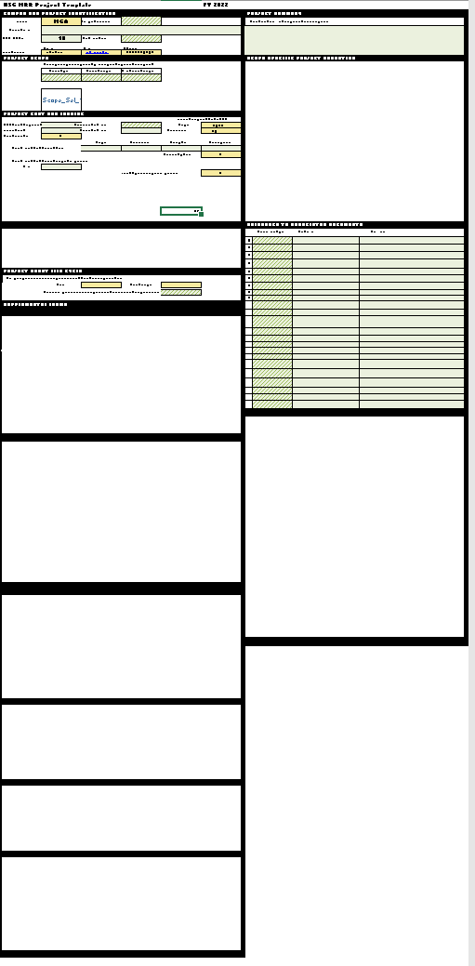
USG MRR PROJECT TEMPLATE FY 2026
REFERENCE AND INFORMATION
Contents:
Key Issues and Cautions 2
Primary New/Revised Features 3-9
Template Navigation Aids 10-11
Template Structure Breakdown 12-32

Slide 2
USG MRR PROJECT TEMPLATE FY 2026
KEY ISSUES/CAUTIONS – TAKE HEED FOR BEST RESULTS:
Large file will load slowly
If you are not using the most current Excel desktop version or Excel 365, the dynamic arrays that provide available unique project priority selection will not work. If you have issues, please work with your ITS support team to get an updated version of Excel
The workbook structure IS NOT LOCKED so as to enable automatic tab naming based on selected project prioritization. To protect workbook logic and function:
  DO NOT INSERT NEW SHEETS
  DO NOT UNHIDE ANY HIDDEN SHEETS
  DO NOT DELETE ANY SHEETS
  DO NOT RENAME ANY PROJECT TABS DIRECTLY
Using template in a shared environment and editing/saving in a shared drive can potentially cause corruption in the macro coding:
  IF POSSIBLE, TRY TO SAVE THE TEMPLATE FILE TO A LOCAL HARD DRIVE
  BACK THE FILE UP FREQUENTLY TO A LOCAL HARD DRIVE

Slide 3
USG MRR PROJECT TEMPLATE FY 2026
PRIMARY FEATURES
ID Institution and Contact Sheet 4
Template file now institution-specific 4
Preloaded original FY22 project sheets 5
Project priority selection 6
Project and prioritization review summary 7-8

Slide 4
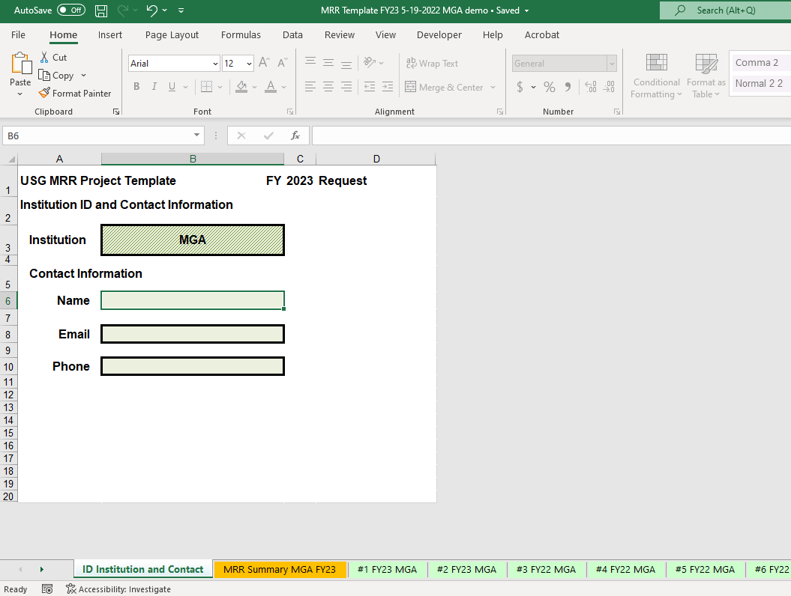
USG MRR PROJECT TEMPLATE FY 2026
Primary Features
ID Institution and Contact Sheet
Since Institution is pre-selected, template files are now institution-specific
Fill out contact info

Slide 5
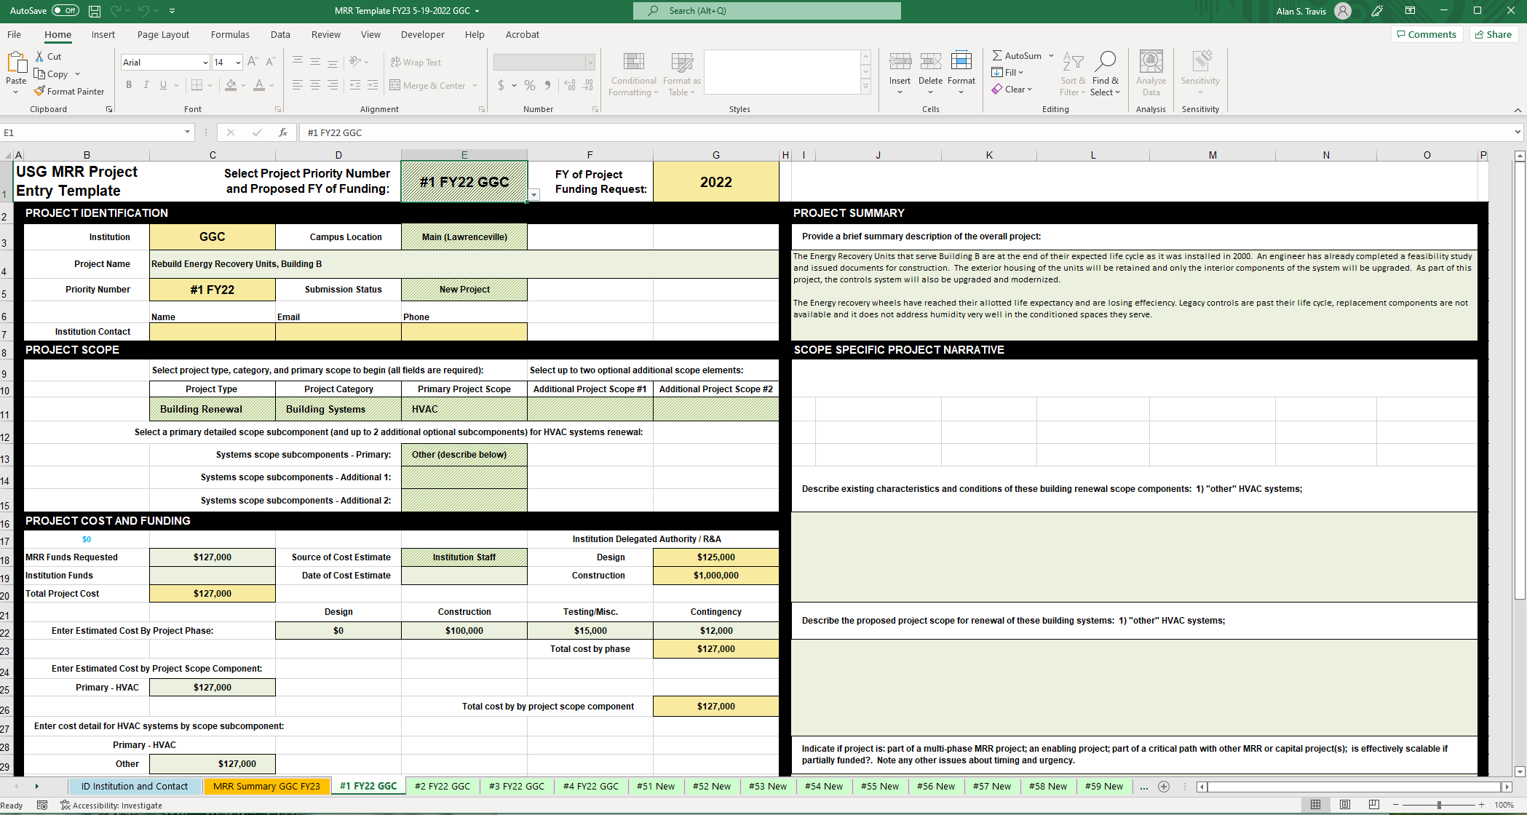
USG MRR PROJECT TEMPLATE FY 2026
Primary Features
Preloaded FY25 Project Sheets
All original FY25 Project information tabs are preloaded into the FY26 Template.
In some cases, unfunded FY25 projects have been updated to FY26 prioritization.
You have several options with previous FY tabs:
  Leave them alone– they do not have to be cleared and reused.
  Bring FY25 projects forward into FY26 request as-is
  Edit and update the FY25 projects brought into FY26.
Template file also contains a number of blank new project tabs, which can be brought into FY26 and filled out with new project information.

Slide 6
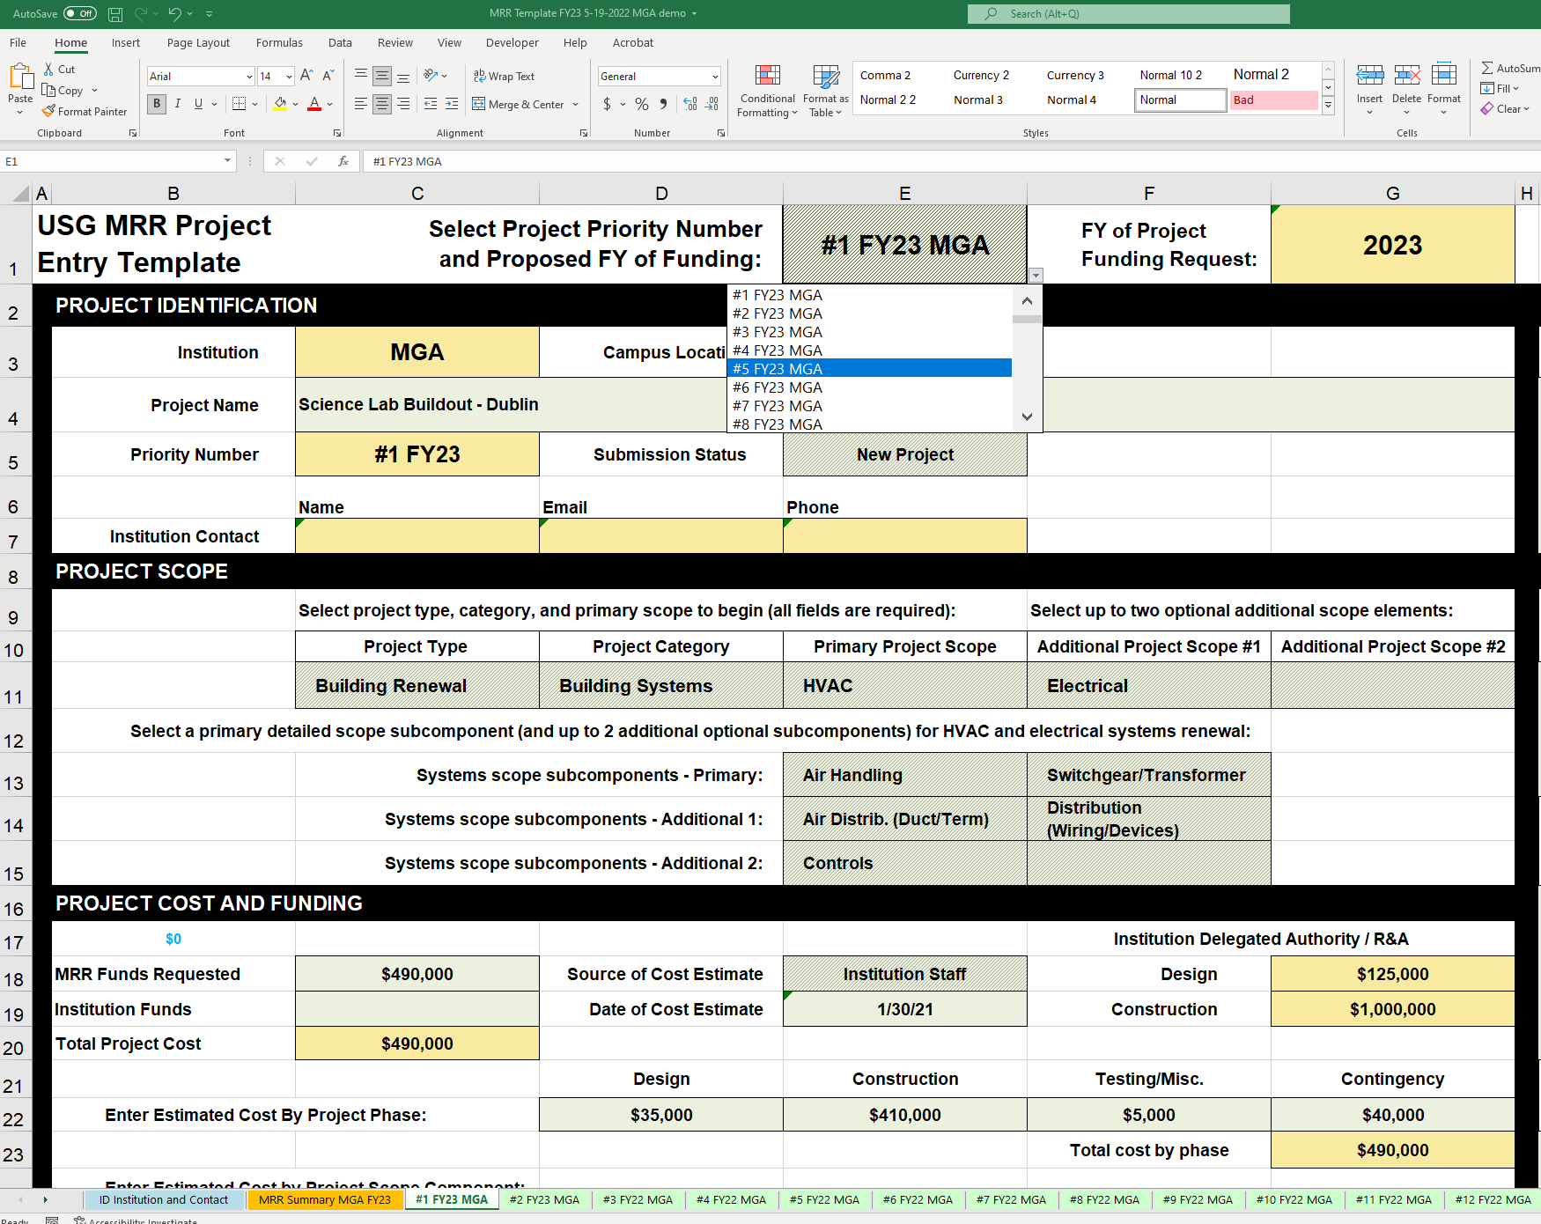
USG MRR PROJECT TEMPLATE FY 2026
NEW FEATURES
Project Priority Selection
FY of proposed project funding and priority order within FY are selected in Cell E1 dropdown on each project tab
Dropdown will only allow selection of numbers that are not yet selected
Changing prioritization will automatically change the sheet tab name once you select any cell other than E1 (move the cursor to the project name cell to activate)
You can select available FY26 project priority numbers or one of 26 available placeholder project IDs (PH-A - PH-Z)
FY26 Projects must have key fields populated and be in sequential order beginning with #1 to populate the FY26 BOR summary

Slide 7
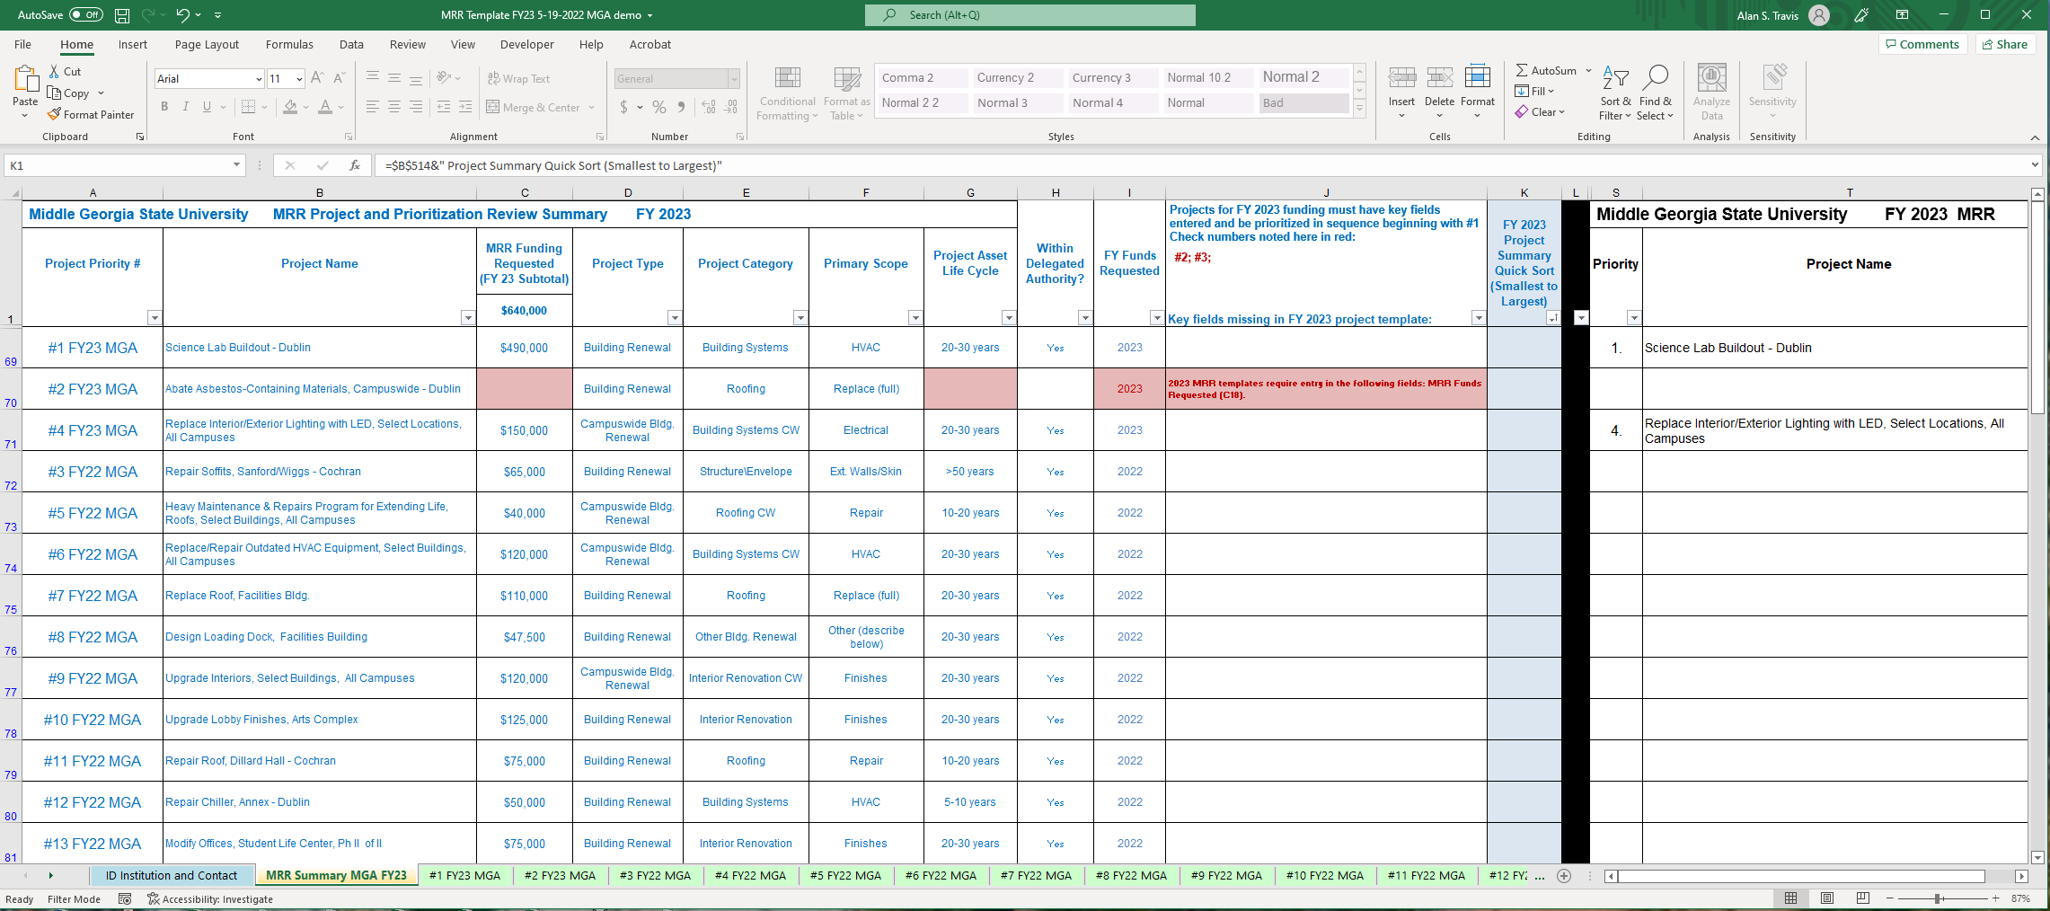
USG MRR PROJECT TEMPLATE FY 2026
Project And Priority Review Summary
Summary review tool begins at A1 in blue font.
Summary automatically updates as edits are made in project tabs
FY23 projects must be sequential beginning with #1 – missing or incomplete FY23 projects are automatically noted in J1
Key fields that are missing in the individual FY23 project templates are highlighted in red.
Any missing key fields and their template cell reference are also identified in project specific notes in Col J

Slide 8
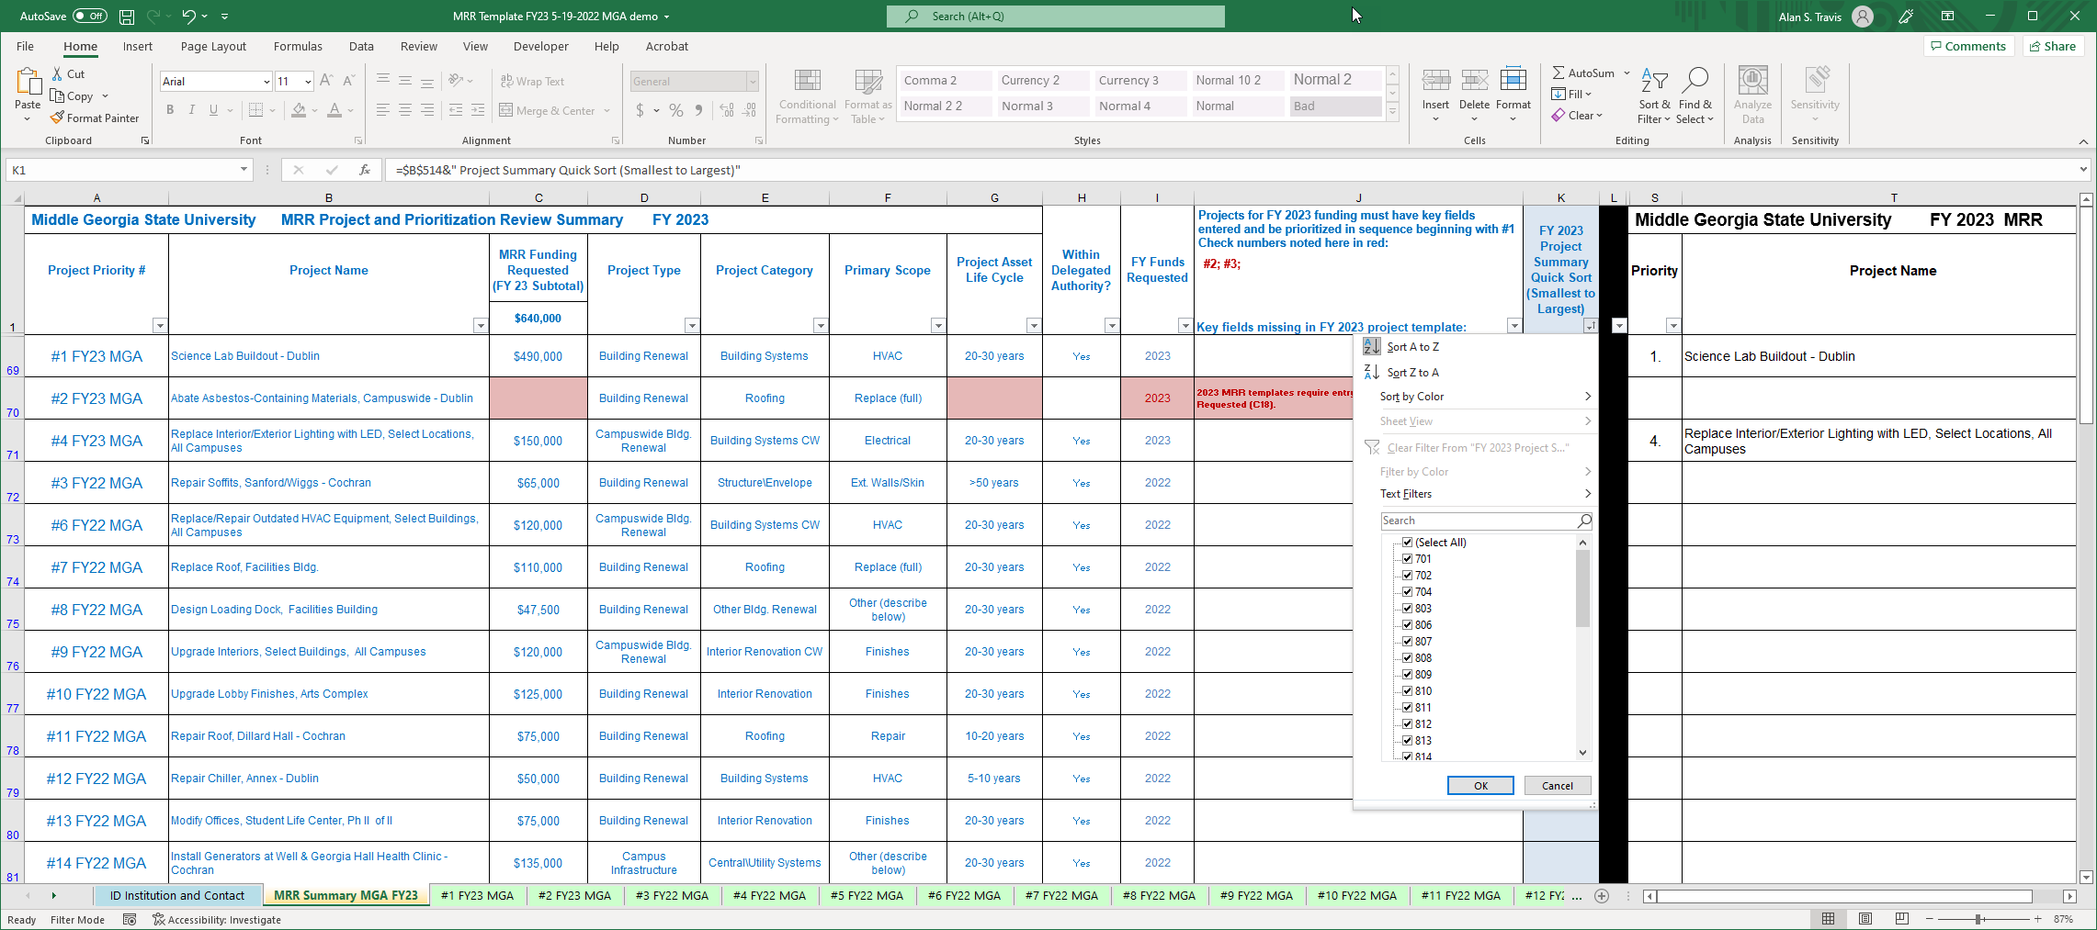
USG MRR PROJECT TEMPLATE FY 2026
Project And Priority Review Summary
The summary can be sorted – the easiest way to reset the project priorities in logical order is to use the “Quick Sort” in Cell K1 – “sort A-Z” to reset the summary projects in the following order:
  FY26 1-x
  Any previous FY projects
  Placeholders PH-A – PH-Z
  Blank New Project Tabs
Any FY26 project without key information (Project Type/Category/ Primary Scope, amount of MRR $ requested) will not carry over to the FY26 BOR summary in black font beginning in Column S

Slide 9
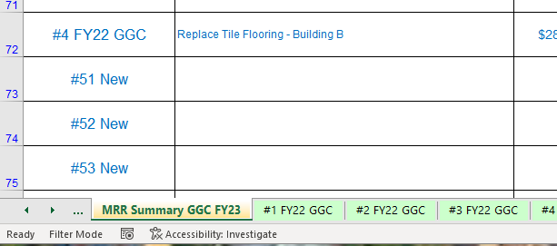
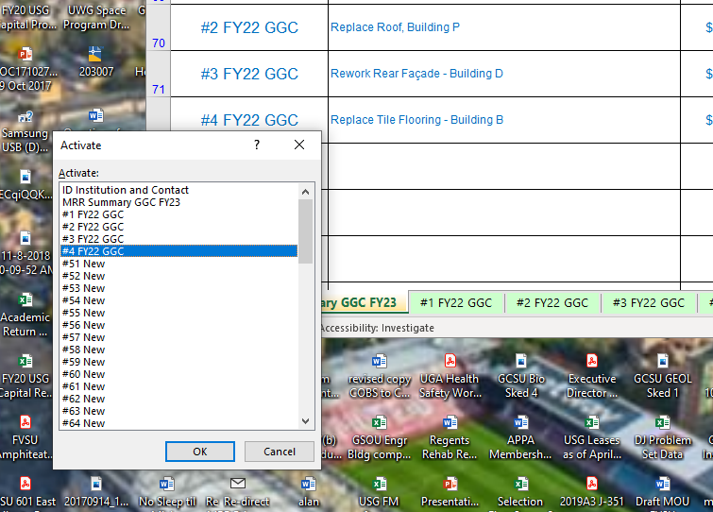
USG MRR PROJECT TEMPLATE FY 2026
Template Navigation Aids
To go directly to a specific tab:
Right Click between the arrows on the navigation menu in lower right corner of screen
b. Highlight desired tab and left click “OK”

Slide 10
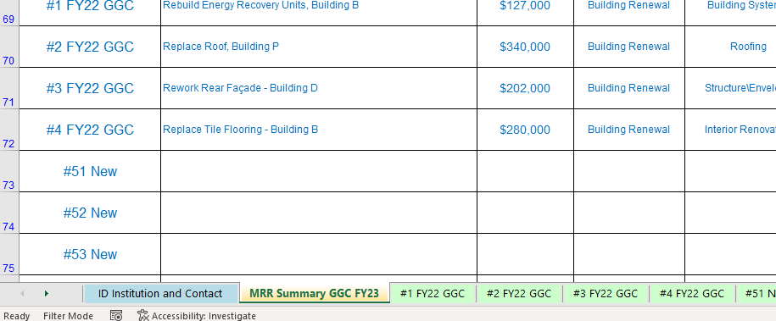
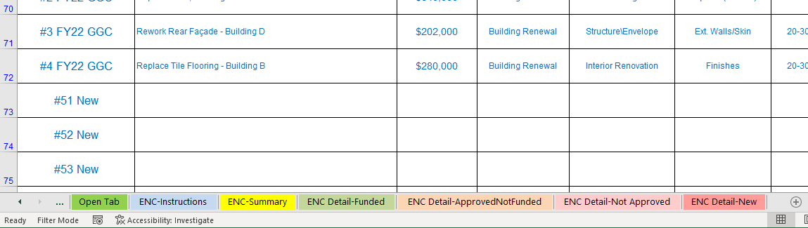
USG MRR PROJECT TEMPLATE FY 2026
Template Navigation Aids
To jump directly to the beginning or end of the workbook sheet tab array without scrolling:
Press “Ctrl” and left click the left arrow to go directly to the beginning (left edge) of the worksheet tab array
Press “Ctrl” and left click the right arrow to go directly to the tab at the beginning of the worksheet array

Slide 11
USG MRR PROJECT TEMPLATE FY 2026
Other Issues:
Macro coding has been repaired to prevent VBA error dialogs when selecting and changing Project Type/Category/Scope. If you do happen to get a VBA error message, click “End” to move on – do not try to debug.
When changing Project Type/Category/Scope, all downrange data fields will clear and reset with two exceptions:
  Exception 1 - narrative text boxes (other than project summary) must be manually cleared.
  Exception 2 – the coding that clears the entry for secondary cost information in C29-31 on some projects does not work in all circumstances – you may need to clear these cells manually depending on your selections.

Slide 12
USG MRR PROJECT TEMPLATE FY 2026
Template Structure Breakdown

Slide 13
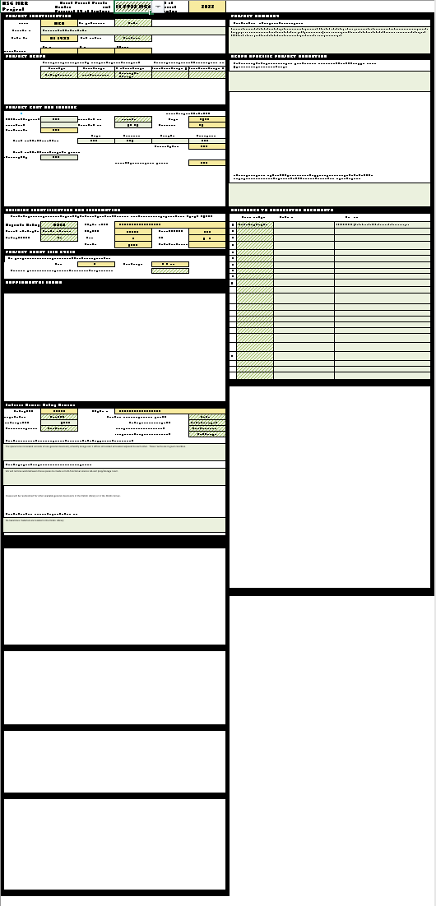
MMAIN PROJECT FORM
(Rows 1-47)
Campus and Project ID
Project Scope
Project Cost and Funding
Building ID and Info
Project Asset Life Cycle
NARRATIVE FORMS
Project Summary
Scope-Specific
Narrative
DOCUMENT REFERENCE
SUPPLEMENTAL FORMS
Rows 48-166
Roofing
Interior Renovation
Chillers
(HVAC/Central Plant)
Air Handling
DX Systems
Boilers
(HVAC/Central Plant)
BOR R&A Form (autofill)

Slide 14
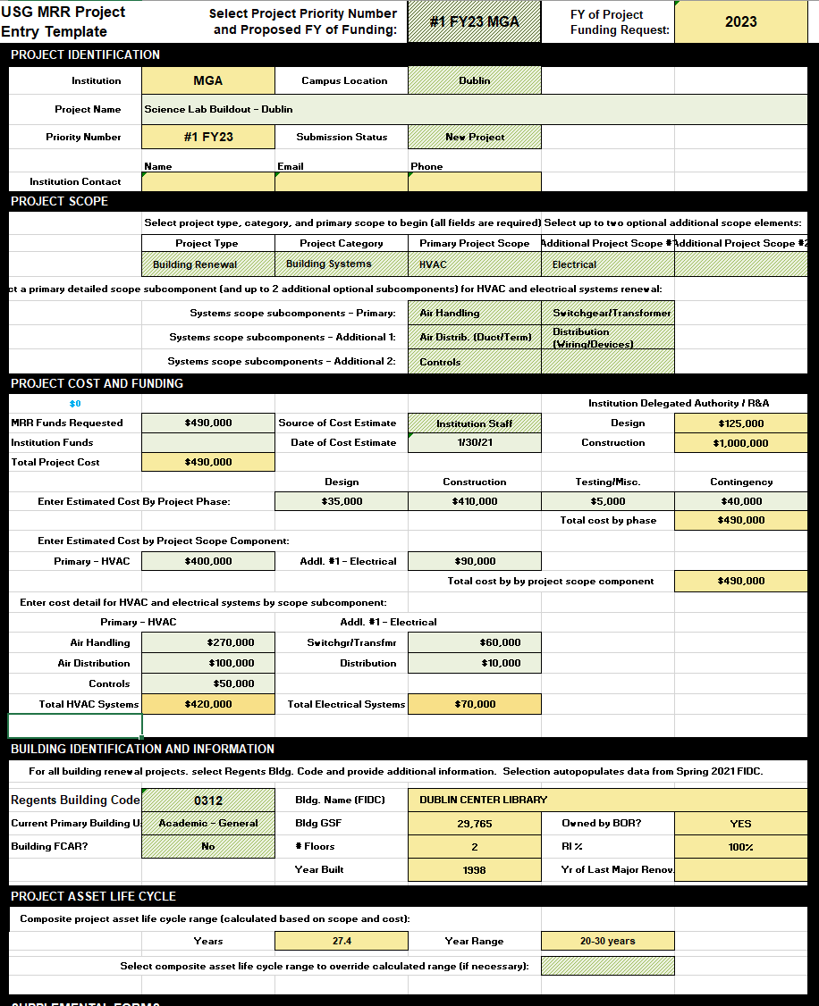

Slide 15
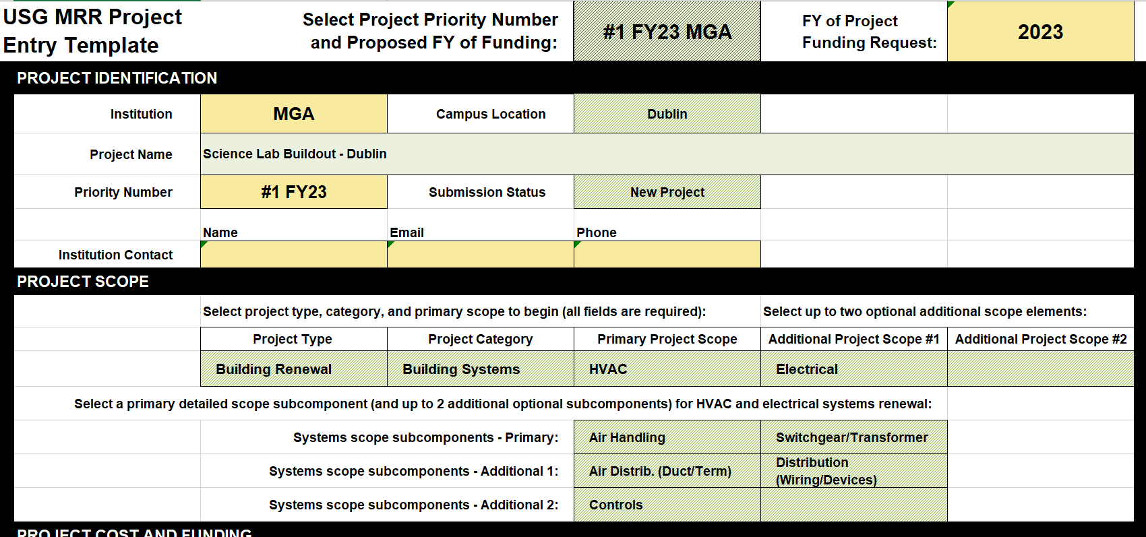
Project Scope
3 Minimum Required Scope Fields for all projects
Project Type
Project Category
Primary Project Scope
Project won’t populate FY26 request without entry

Slide 16
Project Scope
3 Project Types – SELECT ONE
Building Renewal
Campus Infrastructure
Campuswide Building Renewal

Slide 17
Project Scope
Project Categories – SELECT ONE
Specific to Project Type

Slide 18
Project Categories
BUILDING
RENEWAL
Building Systems
Roofing
Structure/Envelope
Life Safety
Compliance
Interior Renovation
Other
CAMPUS INFRASTRUCTURE
Central/Utility Systems
Vehicle/Ped Circulation
Life/Safety/Compliance
Other
CAMPUWIDE BLDG. RENEWAL
Building Systems
Roofing
Structure/Envelope
Life Safety
Compliance
Interior Renovation
Other

Slide 19
Project Scope
Primary scope is minimum depth for project ID
Refine scope of Building Renewal and Infrastructure by adding project scope elements

Slide 20
Project Scope
For HVAC, Electrical, and Central Plant Scope – enter at least one systems scope subcomponent

Slide 21
MRR Project Scope Tree – Campus Infrastructure
Proj Type |  | Campus Infrastructure
 | Category |  | Central/Utility Systems |  |  |  |  |  |  |  |  |  | Veh\Ped Circulation |  |  |  | Life Safety\ Compliance |  |  |  | Other Infrastructure
 |  | Scope |  | Central Plant |  |  |  |  | Chilled Water (distribution) |  |  |  |  | Streets/Driveways |  |  |  | Accessibility
 |  |  | SubScope |  | Controls |  |  |  | Hot Water/Steam (distribution) |  |  |  |  | Sidewalks |  |  |  | Remediation
 |  |  |  |  | Chiller (repair) |  |  |  | Electric (site lighting) |  |  |  |  | Hardscape |  |  |  | Access/Security
 |  |  |  |  | Chiller (replace) |  |  |  | Electric (distribution) |  |  |  |  | Parking (surface) |  |  |  | Other
 |  |  |  |  | Cooling Tower |  |  |  | Water (domestic/fire) |  |  |  |  | Wayfinding
 |  |  |  |  | Boiler (repair) |  |  |  | Gas |  |  |  |  | Other
 |  |  |  |  | Boiler (replace) |  |  |  | Sanitary Sewer
 |  |  |  |  | Cent. Elec. (transfr/switchgr) |  |  |  | Stormwater
 |  |  |  |  | Central Electric (Generation) |  |  |  | Data/Fiber/Low Voltage
 |  |  |  |  | Other |  |  |  | Other

Slide 22
MRR Project Scope Tree – Campuswide Building Renewal
Proj Type |  | Campuswide Bldg. Renewal
 | Category |  | Building Systems (CW) |  |  |  |  |  |  |  |  |  | Roofing CW |  |  |  | Structure\ Envelope CW |  |  |  | Life Safety CW |  |  |  | Compliance CW |  |  |  | Interior Renovation CW |  |  |  | Other CW Bldg. Renewal
 |  | Scope |  | HVAC CW |  |  |  |  | Electrical CW |  |  |  |  | Repair |  |  |  | Ext. Windows/Doors |  |  |  | Emergency Lighting/Signage |  |  |  | Accessibility |  |  |  | Interior Renovation CW
 |  |  | SubScope |  | Controls |  |  |  |  | Lighting |  |  |  | Replace (full/sections) |  |  |  | Ext.Walls/Skin |  |  |  | Emergency Generator |  |  |  | Abatement |  |  |  | Finishes
 |  |  |  |  | Chiller (repair) |  |  |  |  | Switchgear/ Transformer |  |  |  | Other |  |  |  | Fdn./Superstruc./Stairs |  |  |  | Fire Detection/Alarm |  |  |  | Lab Fume Hoods |  |  |  | Instructional Upgrades
 |  |  |  |  | Chiller (replace) |  |  |  |  | Distribution (Wiring/Devices) |  |  |  |  |  |  |  | Other (describe below) |  |  |  | Fire Sprinkler |  |  |  | Other (describe below)
 |  |  |  |  | Air Handling |  |  |  |  | Other |  |  |  |  |  |  |  |  |  |  |  | Access/Security
 |  |  |  |  | Air Distrib. (Duct/Term) |  |  |  | Plumbing CW |  |  |  |  |  |  |  |  |  |  |  |  | Other (describe below)
 |  |  |  |  | DX Systems |  |  |  | Elevators
 |  |  |  |  | Boiler (repair) |  |  |  | Data/Low Voltage
 |  |  |  |  | Boiler (replace) |  |  |  | Other
 |  |  |  |  | Other

Slide 23
MRR Project Scope Tree – Building Renewal
Proj Type |  | Building Renewal
 | Category |  | Building Systems (CW) |  |  |  |  |  |  |  |  |  | Roofing |  |  |  | Structure \Envelope |  |  |  | Life Safety |  |  |  | Compliance |  |  |  | Interior Renovation |  |  |  | Other Bldg. Renewal
 |  | Scope |  | HVAC |  |  |  |  | Electrical |  |  |  |  | Repair |  |  |  | Exterior Windows/ Doors |  |  |  | Emergency Lighting/Signage |  |  |  | Accessibility |  |  |  | Finishes
 |  |  | SubScope |  | Controls |  |  |  |  | Lighting |  |  |  | Replace (section) |  |  |  | Ext. Walls/ Skin |  |  |  | Emergency Generator |  |  |  | Abatement |  |  |  | Instructional Upgrades
 |  |  |  |  | Chiller (repair) |  |  |  |  | Switchgear /Transformer |  |  |  | Replace (full) |  |  |  | Foundation/ Superstruc./ Stairs |  |  |  | Fire Detection/ Alarm |  |  |  | Lab Fume Hoods |  |  |  | Reconfiguration (Same Use)
 |  |  |  |  | Chiller (replace) |  |  |  |  | Distribution (Wiring /Devices) |  |  |  | Other |  |  |  | Other |  |  |  | Fire Sprinkler |  |  |  | Other |  |  |  | Reconfiguration (Use Change)
 |  |  |  |  | Air Handling |  |  |  |  | Other |  |  |  |  |  |  |  |  |  |  |  | Access/Security |  |  |  |  |  |  |  | Other
 |  |  |  |  | Air Distrib. (Duct/Term) |  |  |  | Plumbing |  |  |  |  |  |  |  |  |  |  |  |  | Other
 |  |  |  |  | DX Systems |  |  |  | Elevators
 |  |  |  |  | Boiler (repair) |  |  |  | Data/Low Voltage
 |  |  |  |  | Boiler (replace) |  |  |  | Other
 |  |  |  |  | Other

Slide 24
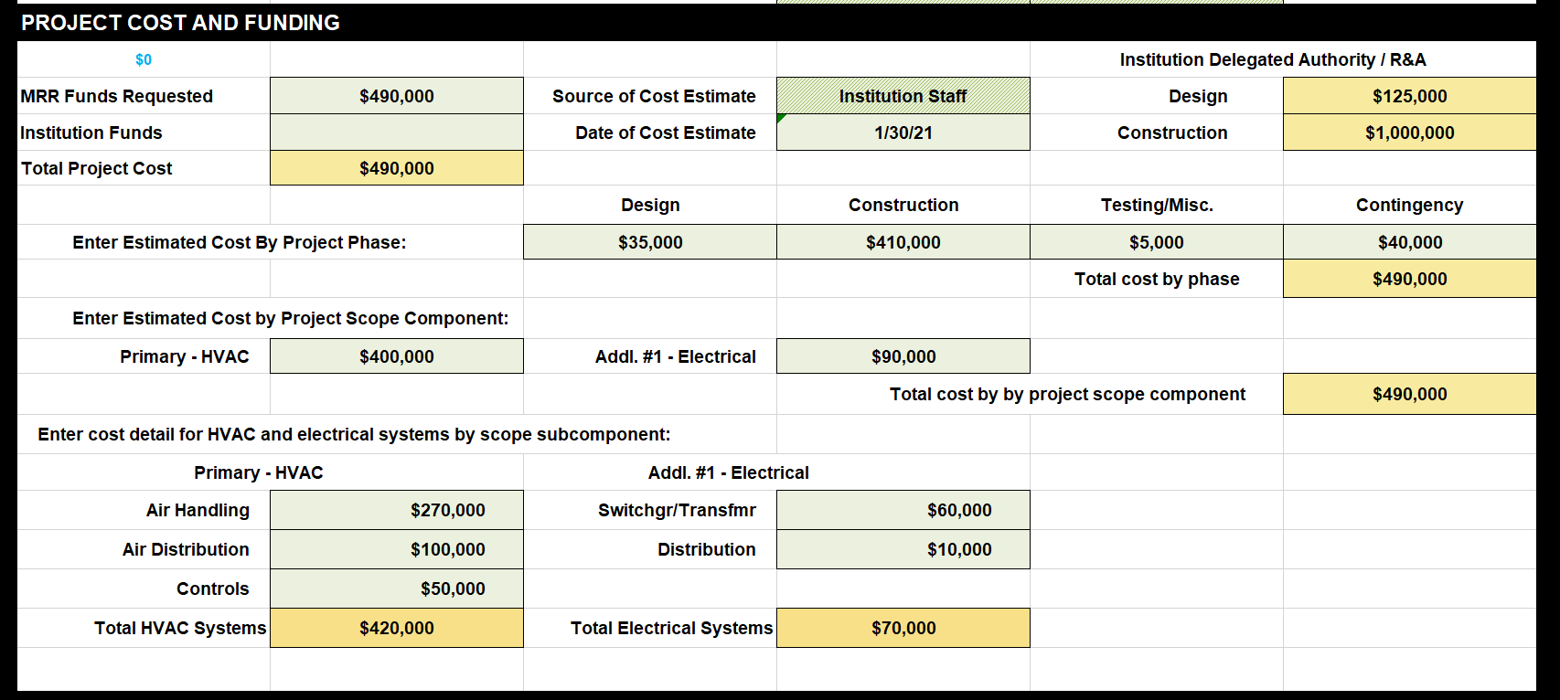
Project Cost and Funding
All funding info must be entered for FY26 projects
  MRR Funds requested required to populate FY26 summary
  Cost by project phase and scope component required to populate Asset Life Cycle range

Slide 25
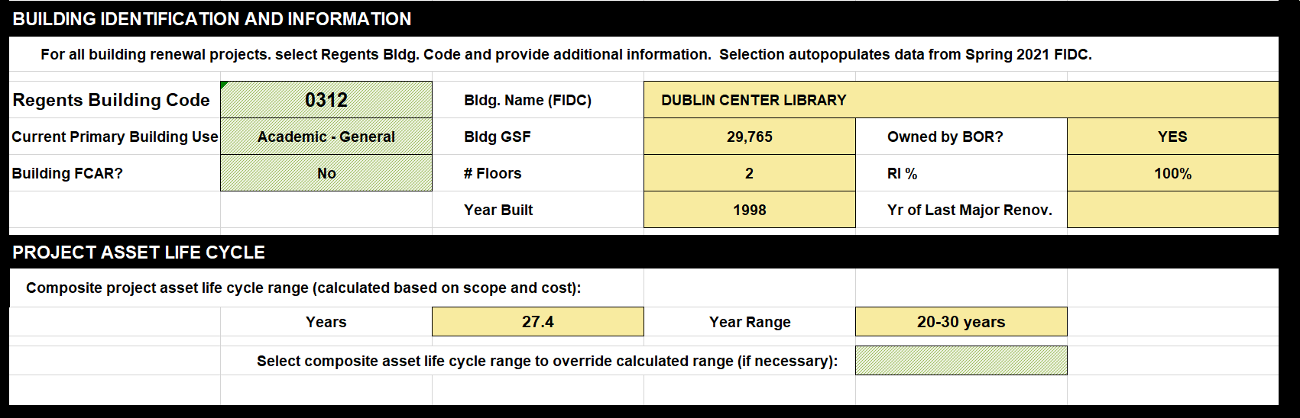
Building ID
Required for:
Building Renewal projects
Central Plant Projects (within building)
Use FIDC tab near end of tab array to locate correct Regents Building Code

Slide 26
Supplemental Forms
Roofing (Rows 49-67)
Interior Renovation (Rows 69-98)
HVAC – Chiller (Rows 101-120)
HVAC – Air Handling (Rows 121-135
HVAC – DX Systems (Rows 137-148)
HVAC – Boilers (Rows 149-165)

Slide 27
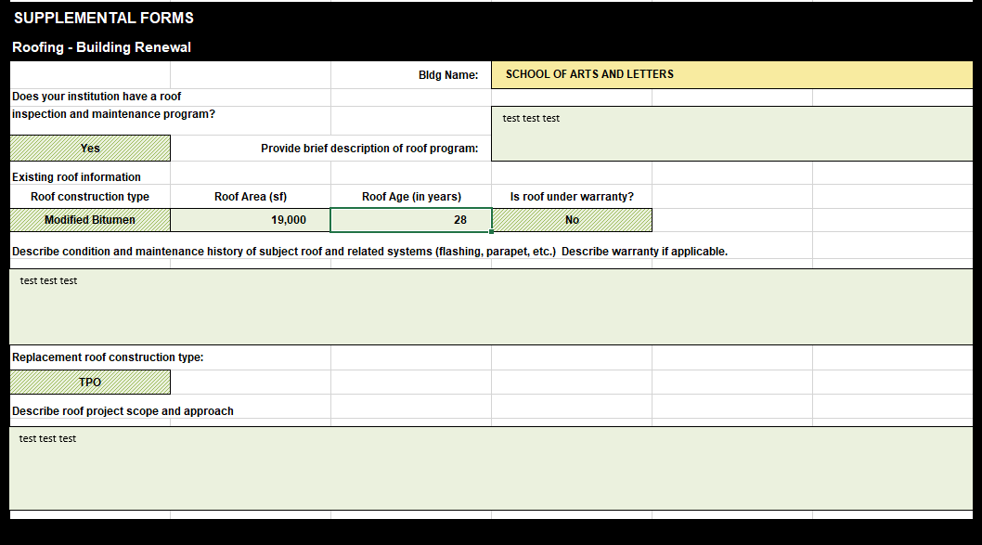
Supplemental Forms

Slide 28
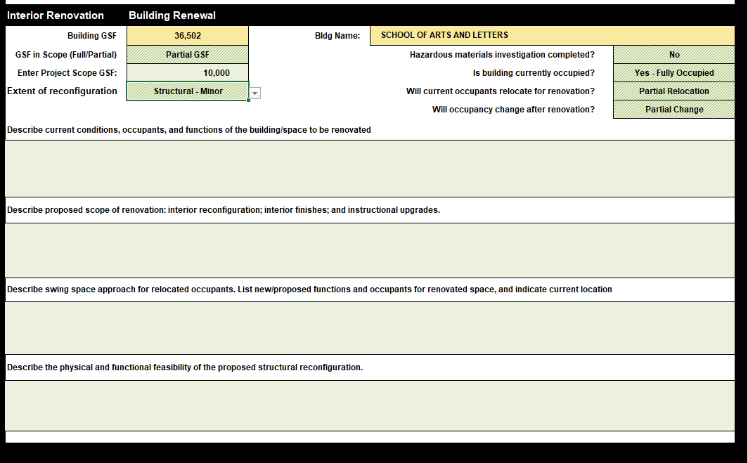
Supplemental Forms

Slide 29
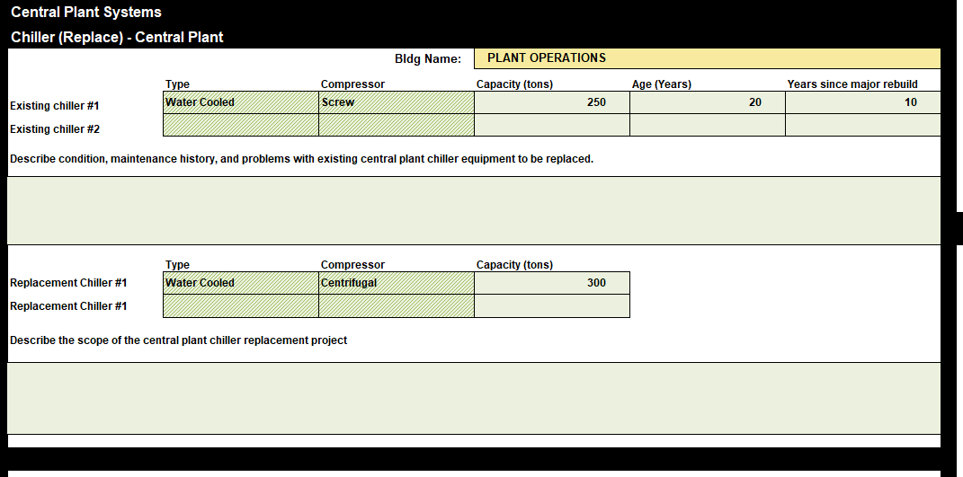
Supplemental Forms
CHILLER

Slide 30
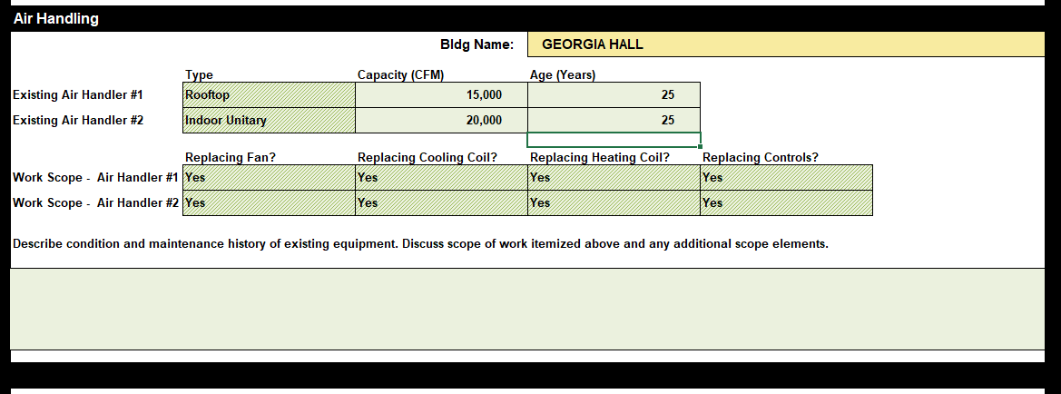
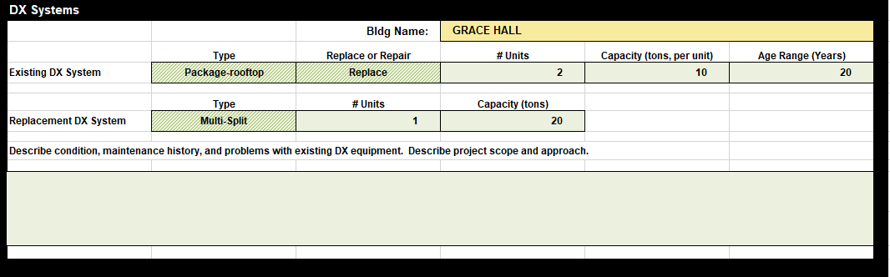
Supplemental Forms
AIR HANDLING
DX SYSTEMS

Slide 31
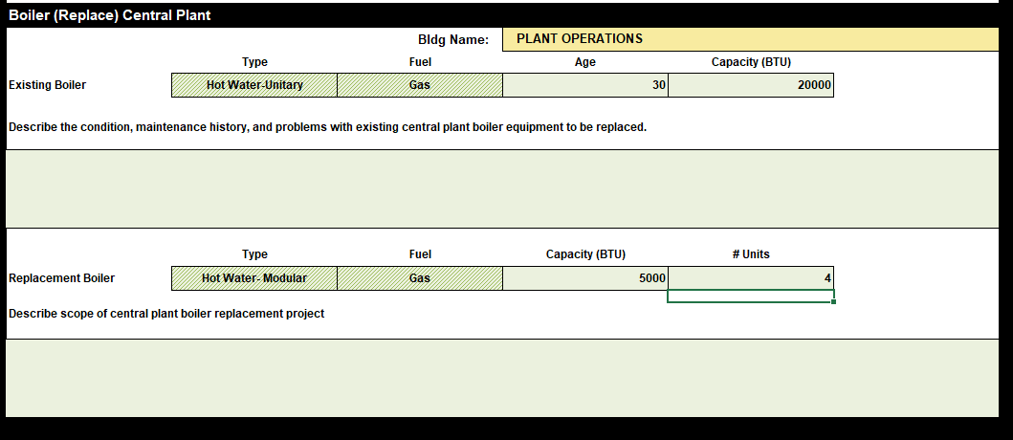
Supplemental Forms
BOILER

Slide 32
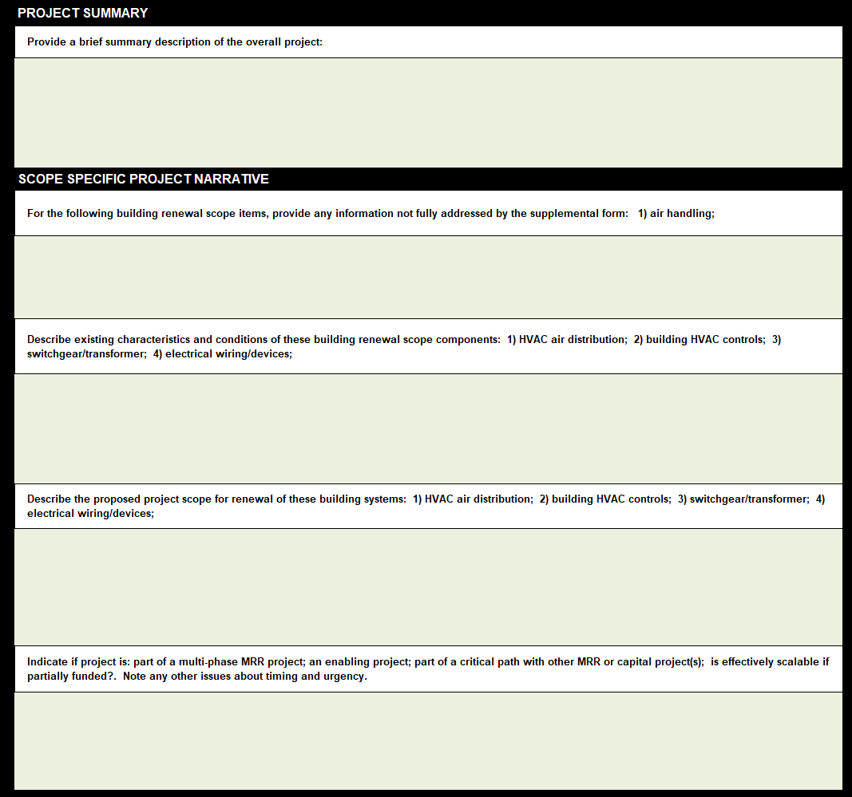
SUMMARY
SCOPE SPECIFIC NARRATIVE

